Slide 1

Assuring financial security with aging, or practicing whealthcare
Jason Karlawish, MD
University of Pennsylvania

Slide 2
A Presidential Proclamation
NOW, THEREFORE, I, BARACK OBAMA, President of the United States of America, by virtue of the authority vested in me by the Constitution and the laws of the United States, do hereby proclaim June 15, 2016, as World Elder Abuse Awareness Day. I call upon all Americans to observe this day by learning the signs of elder abuse, neglect, and exploitation, and by raising awareness about this important public health issue.
June 15, 2016

Slide 3
Financial security and cognitive health in the aging population
A public health issue has….
  harms to many people
  many causes
  benefits from education and empowerment, surveillance and prevention
Education, empowerment, surveillance and prevention are actionable at the level of the individual, community and society

Slide 4
Whealthcare…
Age-related biological changes cause problems
  starting in our fifth decade cognition changes and one of the first signs of cognitive health problems is changes in financial capacity
  chronic disease creates isolation & caregivers
Older adults place a high value on maintaining their cognition
  top priorities are preserving memory, staying sharp, and wealth
Older adults are typically in a transition from accumulating to deccumulating wealth
  wealth may be spread over multiple accounts and connected to checkbooks and credit cards, mortgages, co-signatures on student loans
www.whealthcare.org

Slide 5
Financial security and cognitive health in the aging population
The U.S. has a national Alzheimer’s plan
  Goal #3: effectively treat & prevent AD by 2025

Slide 6
Financial security and cognitive health in the aging population
Pills and technology alone won’t prevent or solve financial fraud or abuse, or errors from losses in financial capacity….
So how can we set up a system that prevents, detects and minimizes harms?

Slide 7
Individual
Societal
Community
Relationships
Whealthcare
Achieve Financial Security with Aging

Slide 8
Individual
Knowledge, attitudes, beliefs.
Cognition
Societal
Culture and values
Local, state and national regulators
Foundations & advocacy groups
Community
Banks & financial services companies
Health care system
Adult protective services
Law enforcement
Foundations & advocacy groups
Relationships
Formal and informal
Support (family, friends, peers)
Health care professionals
Banking & Financial Professionals
Whealthcare
Achieve Financial Security with Aging

Slide 9
Individual
From accumulation to deccumulation
Health is a top priority and then wealth
Social isolation
Aging brain
  changes in cognition caused by diseases
  changes in cognition caused by aging
  changes in emotional and time perspectives

Slide 10
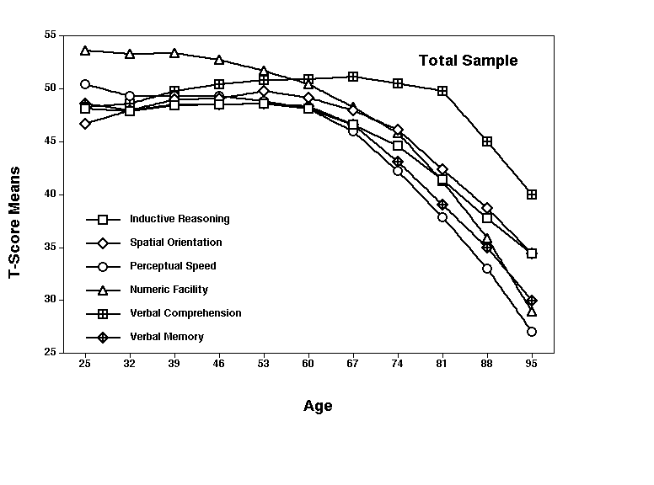
Longitudinal Age Changes
Schaie, K.W., Developmental Influences on Adult Intelligence, Seattle Longitudinal Study Second Edition,. New York, Oxford University Press.
Notes:
10

Slide 11
Future Time Perspective declines over chronologic age

Slide 12
Individual
Financial capacity is among the earliest abilities affected by changes in the aging brain
  changes in financial capacity lead to errors or bad decisions and create a risk of scams, fraud or abuse
They need interventions to prevent cognitive loss, education and empower, and plan ahead…

Slide 13
Relationships
Health care professionals
Family, friends, and neighbors
Bankers and financial professionals

Slide 14
Relationships
Health care professionals
  diagnose & treat geriatric syndromes could benefit from more real world information
Family, friends, and neighbors
  informants and helpers who need training
Bankers and financial professionals
  advisors with responsibility who need training

Slide 15
Community
Banking & financial services companies
APS and law enforcement
Health care system
Foundations and advocacy groups

Slide 16
Community, or the case for the multi-disciplinary team
Banking & financial services companies
  technology to monitor financial capacity and to identify persons at risk
  halt suspicious transactions
APS and law enforcement
  investigators, enforcers and service providers who need to be integrated into the other systems
Health care system
  take care of a population by talking with the above
Foundations and advocacy groups
      educate & empower

Slide 17
Societal
  Foundations and advocacy groups
  Banking & financial service industry regulators
Cultural and social norms

Slide 18
Societal
  Foundations and advocacy groups
    push the envelop of ideas & change the defaults
  Banking & financial service industry regulators
    set standards for reporting, holds, fiduciary obligations, identifying third parties
Cultural and social norms
  To preserve our autonomy, we’re going to have to give up some of it.

Slide 19
Practicing Whealthcare….
AARP. BankSafe. 2016

Slide 20
Selected references
www.whealthcare.org (thank you Philip Marshall!)
The National Academies. Cognitive Aging: Progress in Understanding and Opportunities for Action. 2015.
  Chapter 2. “Characterizing and assessing cognitive aging”
  Chapter 6. “Financial decisionmaking”
President’s Council of Advisors on Science and Technology. Independence, Technology, and Connection in Older Age. 2016.
  Chapter 3. “Technologies to address changes in cognitive abilities.”

Slide 21
Selected references
Consumer Financial Protection Bureau, Office of Older Americans, “A Resource Guide for Elder Financial Exploitation Prevention and Response Networks,” August 2016
NCRC. “A New Dawn: Age Friendly Banking.”
AARP. “Snapshots: Banks Empowering Customers and Fighting Exploitation.” 2016

Slide 22
Thank You!
Thank you to NAPSA!
Jason Karlawish
JasonKarlawish@gmail.com
www.whealthcare.org

